Slide 1


Agenda
Student Details:
Name: Akash Kushwaha
Skill Build Email id: akash.2024csit1114@kiet.edu
College: KIET GROUP OF INSTITUTIONS
College Location: Ghaziabad, Uttar Pradesh
Internship Domain: Frontend Development
Starting and End Date: 12/06/23 to 24/07/2023
Internship Id: INTERNSHIP_168198413964410a8b547b1
Student Id: STU61fd6871d15f81643997297
Phone no: 8874838289
Alternate Email d: akashkushwaha0427@gmail.com

Slide 2


Agenda
Project Title:
LensKart website Clone
The Lenskart Website Clone project seeks to recreate the successful online eyewear platform, Lenskart. It aims to replicate Lenskart's user-friendly interface, extensive product catalog, personalized shopping experience, and convenient services. By cloning the website, users can enjoy a seamless platform for browsing and purchasing eyewear products. Key features such as virtual try-on, home trial service, and a wide range of eyewear options will be included. The clone prioritizes affordability, quality, and convenience, providing an accessible solution to traditional stores. With a focus on user satisfaction and innovation, the Lenskart Website Clone aims to enhance the online eyewear shopping experience.

Slide 3



Agenda
Introduction and background of the eyewear industry.
Problem statement and challenges faced by consumers.
Overview of the Lenskart project.
Solution and value proposition.
Customization and personalization of the project.
Modelling techniques used.
Results and impact.
Link of GitHub Repository & Published website.
Screenshorts of Cloned Website.

Slide 4

project Overview:
Lenskart's mission to revolutionize the eyewear industry.
Introduction to Lenskart's online platform for eyewear shopping.
Expansion of offline stores for a holistic shopping experience.
Key features and services offered by Lenskart.

Slide 5

Who are the End Users:
Individuals requiring prescription eyewear.
Fashion-conscious consumers looking for trendy sunglasses.
People seeking convenience and affordability in eyewear shopping.
All age groups and demographics.

Slide 6
Our Solution and its Value Proposition:
Extensive range of high-quality eyewear options.
Affordable pricing and attractive discounts.
Home trial service for trying frames before purchasing.
Virtual try-on feature for a personalized shopping experience.
Easy and hassle-free ordering and delivery process.
Excellent customer service and after-sales support.

Slide 7

How did you Customize the Project and Make it Your Own:
In-depth understanding of customer preferences and needs.
Collaboration with renowned eyewear designers for exclusive collections.
Continuous innovation and incorporation of customer feedback.
Investment in technology for seamless online and offline integration.
Focus on building a strong brand identity and customer loyalty.

Slide 8

Modeling:
Implementation of advanced data analytics and machine learning techniques.
Analysis of customer data for personalized recommendations.
Predictive modeling for inventory management and demand forecasting.
Optimization of pricing strategies for increased sales and profitability.

Slide 9

Results:
Significant increase in customer base and sales revenue.
High customer satisfaction and positive reviews.
Improved accessibility to eyewear for a wider audience.
Enhanced brand reputation and recognition.
Expansion into new markets and partnerships

Slide 10
Links:
GitHub project Link:
https://github.com/Akash1437/IBM_Internship_Lenskart_clone
Live site(published on GitHub)
https://akash1437.github.io/IBM_Internship_Lenskart_clone/
Video Link(Drive Link):
https://drive.google.com/file/d/1pWvsIxGRTJ4CuheqUwOu4Qca2KJlppPf/view?usp=sharing

Slide 11
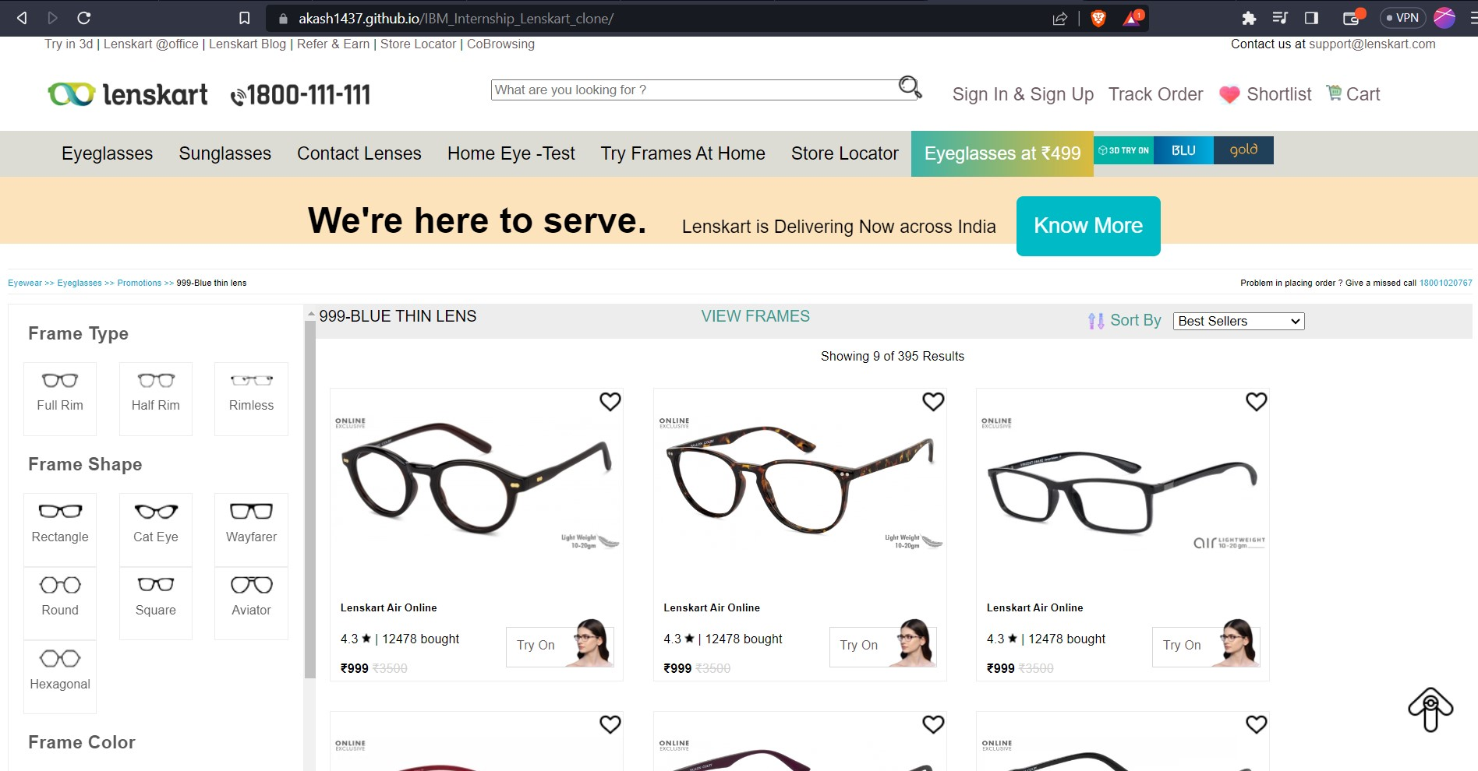
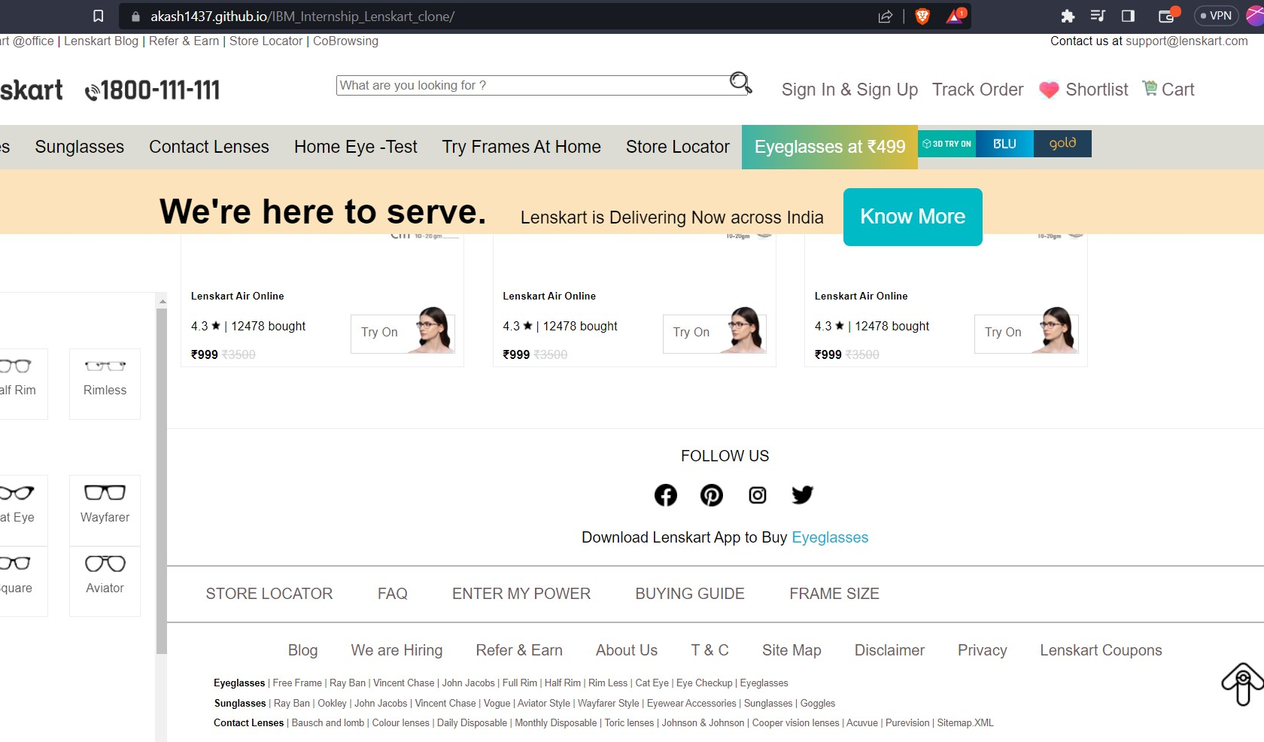
Screenshorts
link:
https://akash1437.github.io/IBM_Internship_Lenskart_clone/

Slide 12

Thank you

